Slide 1
ENTITY RESOLUTION
OLARU MARIA
MADALINA
ASSESSMENT FOR VERIDION

Slide 2



WORKFLOW
Filtering Parameters
Data Normalization
Grouping Entities

Slide 3
FILTERING PARAMETERS
Unique registration code
Company name
Country
Phone number
Email
Website
Adress
Main activity
WHAT TRULY DEFINES A COMPANY?
The answer depends primarily on the type of analysis we want to perform—whether we are looking at a corporate group or a legal entity. Based on the data received, I will focus on analyzing Legal Entities.

Slide 4
FILTERING PARAMETERS
WHAT ARE THE KEY ATTRIBUTES IN THE DATASET THAT WE CAN USE?
Checking for null values in each column
Remove columns with over 90% missing values
Even if a certain attribute is very effective in distinguishing between two records, if it is not sufficiently populated, it cannot be relied upon as a primary feature. However, it can be very useful when the initial grouping does not yield conclusive results.
Choosing grouping parameters
Remove similar columns
Eliminate non-essential or technical metadata

Slide 5
FILTERING PARAMETERS
Remove similar columns - main examples
company_name vs company_commercial_names vs company_legal_names → Keep company_name because it has the most populated values and the others may be misleading
main_country_code vs main_country → Keep main_country_code as it's easier to filter and the values are standardized
website_url, website_domain, website_tld → Keep website_domain is partially cleaned and contains the most important information

Slide 6
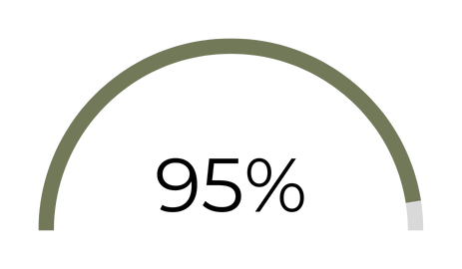
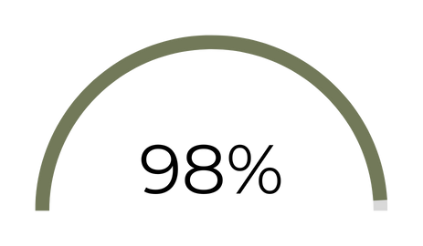

FILTERING PARAMETERS
ESSENTIAL PARAMETERS
main_country_code
company_name
website_domain

Slide 7
THOUGHT PROCESS BEHIND MY SELECTION
FILTERING PARAMETERS
High impact on entity uniqueness - We may have two entities with the same name but in different countries.
Strong filtering dimension
Data completeness and derivability - Even if some values are missing, country information can often be inferred from other fields
main_country_code
High availability across dataset
Strong signal for matching
Primary identifier
company_name
Are typically unique to each company
Difficult to duplicate across entities
Often linked to official identity
website_domain

Slide 8
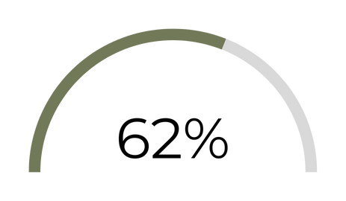
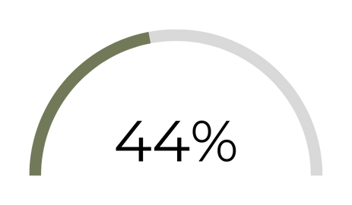
FILTERING PARAMETERS
SECONDARY PARAMETERS
primary_phone
facebook_url

Slide 9
THOUGHT PROCESS BEHIND MY SELECTION
FILTERING PARAMETERS
Going beyond the main parameters, the telephone number, although to a lesser extent, can be defining but also very specific in terms of grouping entities.
primary_phone
If we have made sure they are in the same country and the company name is similar, the facebook URL can be a good indicator to identify if we are talking about the same entity.
facebook_url

Slide 10
FILTERING PARAMETERS
WHY CERTAIN ATTRIBUTES WEREN'T USED?
Main business activity
The data could be outdated by up to two years (based on last_updated_at) and companies may have changed sectors but also the domain field can vary slightly depending on the data source.
Address
When a company operates multiple branches within the same country, filtering by address may inadvertently split a single entity into two or more distinct records.

Slide 11
DATA NORMALIZATION
This step is essential before grouping. After early testing, where match rates were low, I added more normalization techniques beyond the basics (e.g., converting to lowercase, trimming spaces) for company names, like:
Removed elements after the pipe symbol (|), as many values included extra info after the company name
Limited strings to 50 characters – some entries included full descriptions rather than just names, which affected matching
Country code initially with 6.07% missing, reduced to 5.37% by extrapolating from phone number prefixes.
For website domain I eliminated the TLD, it was not necessary, because we will first group by country.

Slide 12
GROUPING ENTITIES
STRATEGY
group by
main_country_code
calculate similarity scores of
company_name
90%
Group entities
70%-90%
Check domain
30%-70%
Check primary phone or
facebook URL
Matched
Group entities
Matched
Group entities

Slide 13
GROUPING ENTITIES
I chose to base the initial grouping on country, as it is the most reliable attribute and can later support the validation of subsequent groupings.
Name-based grouping is at the core of the process and includes three key distinctions. For similarity scores in the 70–90 range, I used domain comparison, as the name alone is not sufficient for a confident match. For scores between 30–70, a stronger level of validation was required — such as matching phone numbers or Facebook URLs.
THOUGHT PROCESS BEHIND GROUPING METHOD
For the 5% of records missing country information, even when cross-referencing multiple attributes (such as company name, domain, or email), it is difficult to establish a reliable match.
International companies often share similar attributes across different countries, which increases the risk of false positives despite these additional checks.

Slide 14
IMPROVEMENTS (NEXT STEPS)
The 2.48% of records missing company names but with strong data completeness can be treated separately.
These can be matched based on domain and verified using other strong identifiers like phone number or email.
Extrapolating country from TLD can be a next good step, into reducing the 5% of the values that aren’t grouped. The downfall is that the most of them are “.com”.
Automated testing on a part of the dataset to determine precision using output values vs expected values mechanism.

Slide 15



0749 612 565
CONTACT
mariamadalinaolaru26@gmail.com
www.linkedin.com/in/maria-mădălina-olaru-8650a318b

